Slide 1
Chapter 3. Specialized security patterns: ASPs, SSAPs, threat and and misuse patterns
E. B. Fernandez

Slide 2
Abstract Security Patterns (ASPs)
Describe a conceptual security mechanism that realizes one or more security policies able to handle (stop or mitigate) a threat or comply with a security-related regulation or institutional policy.
Some of the ASPs correspond to basic security mechanisms, e.g., Access control (Authorization and Reference Monitor), Security Logger/Auditor, and Authenticator.
Others specify more detailed aspects, e.g. Access Control/Authorization models include the Access Matrix, Role-Based Access Control (RBAC), and Multilevel models .
Starting from ASPs, when building the lifecycle of a complete application we can use a hierarchy of patterns going from abstract security patterns to platform-oriented versions of these patterns and their code realizations.

Slide 3
Abstract authentication
Authentication as an abstract function requires a basic sequence of activities:
The subject requests to enter a system indicating its identity and presenting some proof of identity.
If the system recognizes the subject using its identity information, it grants it entrance to the system and provides it with a proof of authentication for further use. If not, the request is denied.
There are many concrete ways to perform these functions in computers and in real life activities

Slide 4
Authenticator ASP

Slide 5
Authentication hierarchy

Slide 6
Credential-based Authentication

Slide 7
Certificate-based authentication

Slide 8
Forces
Closed or open system. If the authentication information presented by the user is not recognized, there is no access. In an open system all subjects would have access except some who are blacklisted for some reason. The rest of the forces refer to closed systems, which are by nature more secure than open systems.
Registration. Users must first register their identity information so that the system can recognize them later.
Flexibility. There may be a variety of individuals (users) who require access to the system and a variety of system units with different access restrictions. We need to be able to handle all this variety appropriately or we risk security exposures.
Availability. We need to authenticate users in a reliable way. This means a robust protocol and a high degree of availability. Otherwise, users may fool the authentication process or enter when the system authentication is down.
Protection of authentication information. Users should not be able to read or modify the authentication information. Otherwise, they can forge ways to give themselves access to the system.
Simplicity. The authentication process must be relatively simple or the users or administrators may be confused. User errors are annoying to them but administrator errors may lead to security exposures.
Reach. Successful authentication only gives access to the system, not to any specific resource in the system. Access to these resources must be controlled using other mechanisms, typically authorization.
Tamper resistance. It should be very difficult to falsify the proof of identity presented by the user.
Cost. There should be tradeoffs between security and cost, more security can be obtained at a higher cost.
Performance. Authentication should not take a long time or users will be annoyed.
Frequency. We should not make users authenticate frequently. Frequent authentications waste time and annoy the users.

Slide 9
Consequences
Closed or open system. In the access policy of the Authenticator we can implement whitelisting or blacklisting policies. The rest of the consequences refer to closed systems, using whitelisting.
Registration. If a subject is not registered there will be no authentication information for it and it will be denied access.
Flexibility. The authentication information can be defined so as to accommodate any type of subjects.
Availability. We can add redundancy to the Authenticator to increase its availability (Buckley et al. 2011).
Protection of authentication information. We can use standard security mechanisms such as authorization to protect the authentication information. Threats T3 and T4 in 2.5.3 can be handled in this way.
Simplicity. We can adjust the protocol to be as simple as necessary for the type of users and the degree of security required.
Reach. Successful authentication only gives access to the system, not to any specific resource in the system. We can add further controls once a subject is admitted.
Tamper resistance. We can define constraints on the type of authentication proof to make it hard to imitate.
Cost. By adjusting the type of authentication proof we can trade off cost for degree of security.
Performance. By adjusting the type of authentication proof we can also adjust the time it takes for authentication. In this way we can trade off performance for degree of security.
Frequency. The proof of authentication avoids the need to re-authenticate subjects.

Slide 10
Additional forces for concrete authentication
Strength. A password must be hard to discover, even for an attacker who has access to the password file and enough computational power.
Protection of Authentication Information. The password file must not be accessible to the users.
Validity. There should be ways to revoke or invalidate portable authentication proofs such as credentials.

Slide 11
Security services

Slide 12
Uses of ASPs
Combine them with patterns describing security principles or good general design principles. For example, the Abstract Authorizer can be combined with Need-to-Know; Single Point of Access can be combined with Firewall.
Can be used to check for security coverage in a design. One of the problems with protecting complex systems is that it is hard for the designers to see if all the high-level security threats have been considered. This is much easier when we work at the application level, we can enumerate threats and find the corresponding security patterns.
Can guide the search for new patterns (pattern mining). An abstract pattern defines a range of patterns and one can see if corresponding patterns exist at all the lower levels, including different environments, e.g. web services or cloud computing.
Can serve as abstract prototypes for similar concrete patterns. Starting from an abstract pattern it is easy to see what security constraints must at least be applied at a specific architectural level. Fr example, from an ASP for VPNs we can derive TLS and IPSec VPNs.

Slide 13
Use of ASPs II
Can serve as ways to connect and relate different families of patterns. For example, a Communication Channel can use Intrusion Detection.
There are patterns for enterprise models to define global security concerns. These patterns include among others: Asset Valuation, Threat Assessment, Security Needs Identification, and others. ASPs can be used to implement their concerns because they are expressed in terms of application functional activities.
We can make generalization hierarchies with patterns, and define patterns which are more and more concrete. For example, starting from a Communication Channel pattern, a Secure Channel denotes a channel where some security measure has been applied, and a Cryptographically-Protected Secure Channel defines a more specific secure communication. We can build SSFs this way.
We can build Domain models or Reference Architectures using ASPs. As indicated DMs and RAs are abstract architectures so they should be built using ASPs.

Slide 14
1..
1..
Application
*
UseCase
*
Activity
Threat
Pattern
encapsulates
*
targets
*
1
Threat
Asset
1
1
*
*
1
*
1
realizes
realizes
1
1
*
1
1
Attack
exploits
Vulnerability
Attack
Pattern
1..
*
*
*
encapsulates
realizes
*
neutralizes
1
Misuse
Pattern
*
SSF
*
*
SC
1
Security
Pattern (SP)
1..
*
SP Family
1..
*
0..1
Compound SP
Simple SP
ASP

Slide 15
Security Solution Frames (SSFs) [Uzu15]
SSFs are solution structures that encapsulate and organize security patterns; they realize security requirements.
They are sets of related patterns that partition the solution space horizontally into separated but related concerns: Pattern Families, and vertically according to levels of abstraction.
Families consider one part needed to fully realize a tactic (to be seen).
A pattern may belong to more than one family.
SSFs can facilitate the work of designers by collecting together all the relevant patterns to realize some security requirements, guiding the designer from an abstract conceptual level to a concrete implementation-oriented level.

Slide 16
Structure of security solution frames (SSFs)

Slide 17
SSF metamodel

Slide 18
SSF structure
SSFs define horizontal and vertical pattern structures.
Horizontal structures, Security Pattern Families(SPFs), correspond to peer-related patterns that complement each other and define different facets of a security policy, while vertical structures are hierarchies of patterns specialized going from ASPs to practical implementations.
ASPs can be used to characterize SSFs and act as roots of these hierarchies, where each lower level is a pattern specialized for some specific context.
For example, a SSF for Authentication includes (among others) a family of Authentication patterns, which in turn includes Application-driven Authentication, Authentication Server, Password-based Authentication, and others.

Slide 19
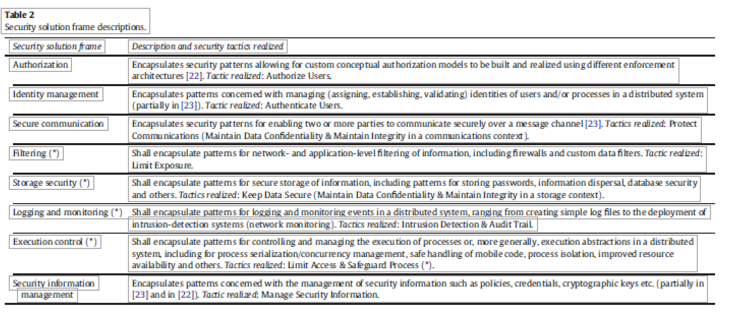

Slide 20
Solution relationships
requires: where solution A requires solution B for its realization
supports: where solution B supports solution A in its realization
depends on: where the realization of solution A is dependent in some fashion on the way solution B is realized.
derives from: where solution B specializes or derives certain characteristics from solution A, having a more specialized context of application.
alternative: where solution B can be used in place of solution A
clashes: where either solution B inhibits the effectiveness of solution A or solutions A and B are altogether incompatible and cannot be realized simultaneously.

Slide 21
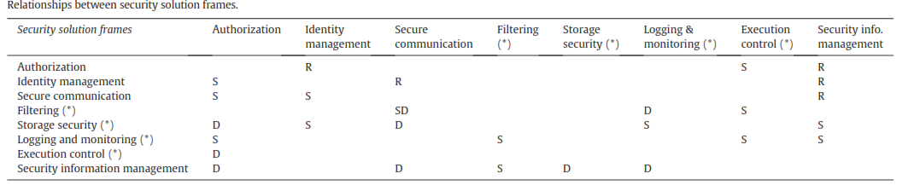
R= requires; S=supports; D=depends on

Slide 22
Security layers

Slide 23
Canonical abstraction levels in distributed systems
Conceptual analysis—contains one or more ASPs to describe the conceptual security solution
Abstract architecture—contains patterns that determine a high-level, abstract architecture for the solution
Solution design—contains patterns refining the abstract architecture using more concrete software components
Practical implementation details—contains patterns about specialized aspects of some technology

Slide 25
A Secure Semantic Analysis pattern (SSAP): Secure Inventory
Inventory describes an stock with different quantities of items in different status and stored in different places (Stockrooms)
Items can be parts or products
Five stakeholders (roles) participate in keeping the inventory of items
Five instantiations of RBAC define the rights of the roles

Slide 27
Some policies for medical information
Patients can see their records, consent to their use, must be informed of their use
A doctor or other medical employee is responsible for use of record (custodian)
Records of patients with genetic or infectious diseases must be related

Slide 29
Regulations
Sarbanes-Oxley Act (SOX) (Federal regulation): SOX establishes standards for all US publicly-traded companies in order to protect shareholders and the general public from accounting errors and fraudulent practices in the enterprise (SOX, 2015). SOX enforces control on user management, system development, program and infrastructure management, monitoring, backup, auditing, and disaster recovery.

Slide 30
Analogy: Sarbanes Oxley policies

Slide 31
OCL (Object Constraint Language)
Similar to Z and SQL, 1st order predicate calculus
Adds precision to UML constraints
Implementation oriented
Important for safety-critical applications

Slide 33
Tactics
A way to apply security to architectures is based on the idea of tactics
Tactics are “measures” or “decisions” taken to improve some quality factor
Another definition: “architectural building blocks from which architectural patterns are created. Each tactic corresponds to a design decision with respect to a quality factor.
Architectural tactics can also be seen as decisions that codify and record best practices for achieving some quality attribute. Tactics are usually expressed in words, but there has been some attempts to formalize them.

Slide 34
Producing secure or reliable architectures from tactics

Slide 35
From policies to patterns

Slide 36
Tactics (improved hierarchy) [Fer15]

Slide 37
Realizations for tactics
Tactic | Security pattern realization
Verify message integrity | Secure Channel with Dig. Signature
Verify storage integrity | Authenticator and Authorizer, Dig. Signature
Maintain audit trail | Security Logger/Auditor
Identify intrusions by signature | Signature(Knowledge)-based IDS
Identify intrusions by behavior | Behavior-based IDS
Authenticate subject | Authenticator (Remote), credential
Authorize subject | Policy, Role and Attribute-Based Access Control
Manage security information | Authorizer, Generation and distribution of public keys
Filter data | Filter, Packet Filter Firewall
Verify origin of message | Digital Signature with hashing
Establish secure channel | Secure Channel
Hide data by encryption | Symmetric and Asymmetric Encryption
Hide data by steganography | Steganographic Encoding
Alert subjects | Abstract IDS
Apply institution policies | Policy-based Enforcement
Audit actions | Security Logger/Auditor

Slide 38
The financial institution

Slide 39
A secure financial institution

Slide 40
Secure architecture for the conceptual model of thr financial institution

Slide 41
Relationships between domain models and application models [Fer11]

Slide 42
Conceptual models and applications
A Conceptual Model describes functional relationships between entities; it realizes a set of use cases (textual descriptions) into a more precise representation.
A Domain Model describes functional relationships between entities related to a specific domain, e.g. finance or electrical engineering.
An Application Model describes the functional aspects of an application and may combine parts of several domain models (takesFrom) as well as its own set of conceptual entities.
Domain models and application models are conceptual models. A conceptual model may include analysis patterns and ad hoc functional units (not patterns).
Some analysis patterns are Semantic Analysis Patterns (SAPs), which correspond to a small set of coherent use cases.
The Policy-enhanced Domain Model (PEDM) and the Policy-enhanced Application Model (PEAM) correspond to domain and application models where we have superimposed policies for security or reliability. In particular, the PEAM inherits policies from some domain models and may add its own policies.

Slide 43
Metamodel for requirements and patterns

Slide 44
Example of going from threats to patterns.

Slide 45
Types of misuse
The outcome of a misuse can be loss of confidentiality or integrity, theft of services, or denial of service.
An attack has a perpetrator, who has a motivation or goal.
The attack has a method of operation to accomplish a mission with respect to a target (modus operandi).
The damage of a mission can be loss of assets, money, lives

Slide 46
Misuse patterns
A misuse pattern describes how an attack intending a misuse of information is performed from the point of view of the attacker. It defines the environment where the attack is performed, countermeasures to stop it, and it provides forensic information in order to trace the attack once it happens
Example: Worm pattern [Fer10]

Slide 47
Worm misuse pattern
Intent
Propagate to as many places as possible (or to specific systems), usually indicating its presence, and maybe performing some damage.
Context
Sites connected through the Internet or another type of network. The Internet provides a variety of services such as email, file transfer, and web services (Figure 1). Any of these services can be used for propagation. Both fixed and wireless networks can be used by the worm. Portable storage devices such as memory sticks can also propagate worms.
Problem
A worm tries to take advantage of any input to invade a system. Users might open attachments carrying worms and some ports of a system may be unprotected or have vulnerabilities; all of these give the worm a chance to invade. Mail systems and file transfer systems for example, include lists of addresses which can be used by the worm to find places where to propagate. Many systems do not control access to their system directories and do not restrict Internet traffic, which facilitates a worm invasion.

Slide 48
Forces I
Objectives. Its objectives may be political, monetary, or vandalism. A political worm typically tries to produce damage to an antagonist; a monetary worm tries to reach many places to collect information or drop spyware; a vandal worm tries to destroy or damage information.
Reach. Try to reach as many places as possible or to specific sites. For most worms, reaching many places is a basic objective.
Presence manifestation. Try to show its presence in the system so victims know about it. Exceptions to this are cases where the objective is to drop spyware.
Credit. To embed an identification or mark so that the creator can take credit for it.
Misuse. Perform some destruction and/or other misuses (confidentiality, integrity, or availability). The misuse may be delayed (time bomb).

Slide 49
Forces II
Obfuscation. Try to hide its structure to make harder its detection and removal.
Collateral damage. In addition to specific misuses, the worm may require costly operations for its removal, stopping or disrupting business activities. Its propagation may affect the normal traffic in the network.
Latency. Its propagation must be as fast as possible to avoid detection and countermeasures.
Activation. This can be done by enticing offers which may tempt users to open email attachments or download procedures (social engineering). Other possibilities are invading through unprotected ports or taking advantage of vulnerabilities

Slide 50
Solution
Attach a core portion of the worm to email messages or to files. When the user opens the message attachments or executes the file the core of the worm starts executing. Alternatively, invade through an unprotected or flawed port. Download remaining portions from complementary network sites. Use some procedure to hide the structure of the worm. Perform its mission and propagate. Figure 2 shows the propagation of a typical worm; speed comes from a tree-like propagation.
Structure
Figure 3 shows a class diagram of the units involved. Class Node represents any node in the network, defined by its address (URL in the Internet). Any node can be the origin of a worm and any node can be its target (and be invaded). Some nodes are complementary sites from which commands or other parts of the worm may be retrieved. Class Worm represents the worm itself, including procedures for initial setup, to bring complementary parts, to hide the worm, to perform its mission, and to propagate.

Slide 51
Worm propagation

Slide 52
Class diagram

Slide 53
Worm propagation

Slide 54
Variants
A passive worm requires a user to activate an executable program and it usually propagates through email. Melissa, ILOVEYOU, Anna Kournikova, and Bagle are examples of this type.
An active worm takes advantage of some system flaw to provoke a buffer overflow or another attack to get in through some port. It may scan looking for unprotected ports. Code Red is an active worm. Storm can be active or passive [Smi08].
A virus attaches itself to some program (infects an executable file) and when the user executes this program it gets activated. Jerusalem, Christmas, and Chernobyl are examples of viruses.
Some worms have several versions with different purposes; for example, Storm has variants that perform different types of misuses, including targeted spam and DDoS attacks [Smi08].
Some worms are multimode (multivector) worms, which can use a variety of ways to invade their targets; for example the Storm virus infects computers using multiple payloads [Smi08].

Slide 55
Known uses
ILOVEYOU [ILO, wor09]. This was an email attachment worm that appeared in 2000. It relied in social engineering to entice users to open the attachment. It also used specific weaknesses of Microsoft Windows. It propagated using the addresses in the address book of the mail system.
Bagle. It was a mass-mailing worm written in assembly language [bag] and affecting all versions of Windows. After activation, it copies itself to the Windows system directory and downloads a SMTP engine to mail its core to other nodes as an attachment (see the Implementation section for its typical behavior).
Code Red [Ber01]. It appeared in July of 2001. It propagated through port 80, indicated its presence by defacing web pages, propagated using a random IP address generator, and later would activate a denial of service attack from infected sites.
Nimda [nim]. Nimda is a multivector worm that can use several ways to propagate: email, visiting an infected site, seeking out vulnerable servers to upload files, or through the network.
Slapper [Arc03]. Can launch denial of service attacks. Propagates finding addresses in files. The nodes invaded by the worm communicate using a P2P protocol to collaborate in their misuses.

Slide 56
Countermeasures
Policy about attachments: Users should be trained to recognize trustable attachments and they should be forbidden to open unknown or suspicious attachments.
Need-to-know policy to define access by system processes to resources. For example, address lists should use authorization to control access to their contents.
Control of network communications: Connections should be established with only trusted addresses (control through the firewalls). This policy may avoid downloads from complementary sites.
Intrusion detection: An IDS can detect some attacks in real time and alert the firewall to stop it.
Use of antivirus software: Can help detect and clean worms after the fact
Backups. Checkpointing files and keeping backup images of them is a fundamental precaution against data destruction or unauthorized modification.
Specialized hardware. Process communication controls in the operating system can be enforced through specialized hardware [Shi00]. It is possible to define partitions in the operating system that can be enforced by hardware and will prevent a worm from performing its actions.

Slide 57
Example of SQL injection attack [Fer12]
A query injection is a threat to a DBMS containing banking information
If there is no input validation (a vulnerability), an SQL injection (SQLi) attack can realize this threat
This threat could lead to a misuse: unauthorized reading of the balance of a bank account (or of many accounts)

Slide 58
SQL attack: assume that the SQL statement template is:

Slide 59
The user adds a statement and gets the salaries for all employees

Slide 60
Modifying the database
SELECT SALARY FROM EMPLOYEE
WHERE EID=‘123’; DROP TABLE EMPLOYEE
Deletes all employees!

Slide 61
Some SQL-based incidents
From November 2004 to January 2005, a hacker by the name of “Hung” used a form of SQL Injection to hack into the databases of Information Security, a well-known magazine, in order to obtain member and commercial information.
In May 2006 a series of Chinese-based websites were attacked using SQL injection. The source of the attacks was a server farm in China.
In August 2009 Albert Gonzales and his associates hacked into databases of a credit card processor and retrieved over 130 million credit card account numbers.

Slide 62
Defenses I
Input validation--Inputs to SQL strings should be constrained and sanitized in terms of the value that should be provided. For example, an input with an integer as its type should have an integer value passed through it and the information passed from the URL should be limited so that important database information is not imparted to possible hackers.
Checking for valid value ranges within the data will also limit SQL injection because, while a controller of a system might have an idea that a passed value can only have a range of 100-200, an attacker would be less likely to know of such a condition.
Using stored procedures with parameter values will prevent improper values from being submitted through the system. When a value is passed into a variable in a stored procedure, the procedure no longer recognizes the value as part of the SQL query even if the value is concatenated with the executing SQL query .

Slide 63
Defenses II
Type checking- basically making sure that if a number is supposed to be passed through a certain variable then a check is placed so that no other value type can be placed within that same variable.
Firewalls – database servers should be located behind a firewall so as to minimize direct access to the database. Firewalls can be installed on the database server or application server. The firewall examines the grammar and structure of SQL statements being send to the database. Certain grammars can be whitelisted or blacklisted.
Web Application Servers – can add an extra layer between web users and the database.
Encryption of specific fields

Slide 64
Other defenses (Imperva)
Detect SQL injection attack. Using a combination of application layer knowledge (application profile) and a preconfigured database of attack vector formats. We must normalize the inspected input to avoid evasion attempts.
Identify access patterns of automated tools. In practice, SQLi attacks are mostly executed using automatic tools. Various mechanisms exist to detect usage of automatic clients, like rate-based policies and enforcement of valid client response to challenges.
Create and deploy a blacklist of hosts that initiated SQLi attacks. This measure increases the ability to quickly identify and block attackers. Since we observed that the active period of host initiating SQLi is short, it is important to constantly update the list from various sources.

Slide 65

Major elements of CF: Threat taxonomies/libraries
Threat taxonomies/libraries consist of threat patterns, which can be customized and instantiated in different architectural contexts to define specific threats to a system.
Allow developers to quickly and efficiently consider a range of relevant threats during threat modeling.

Slide 66
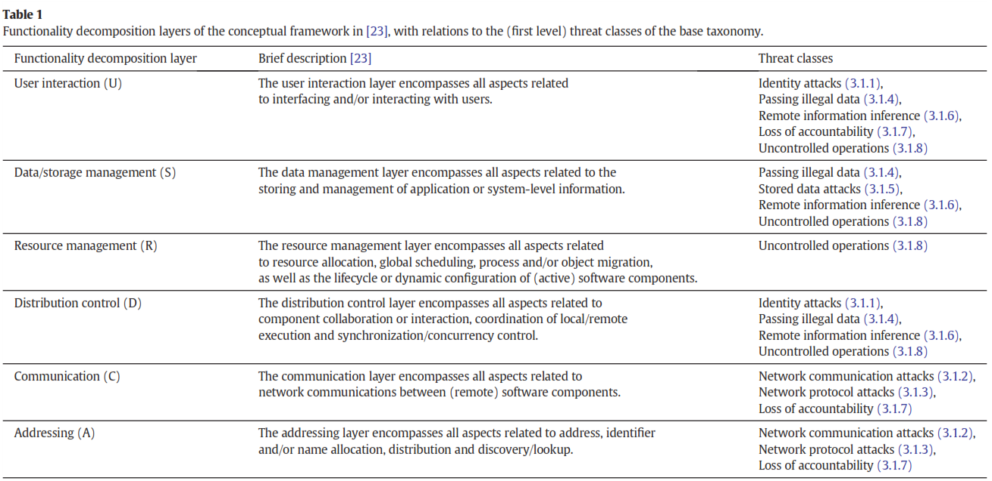

Slide 67
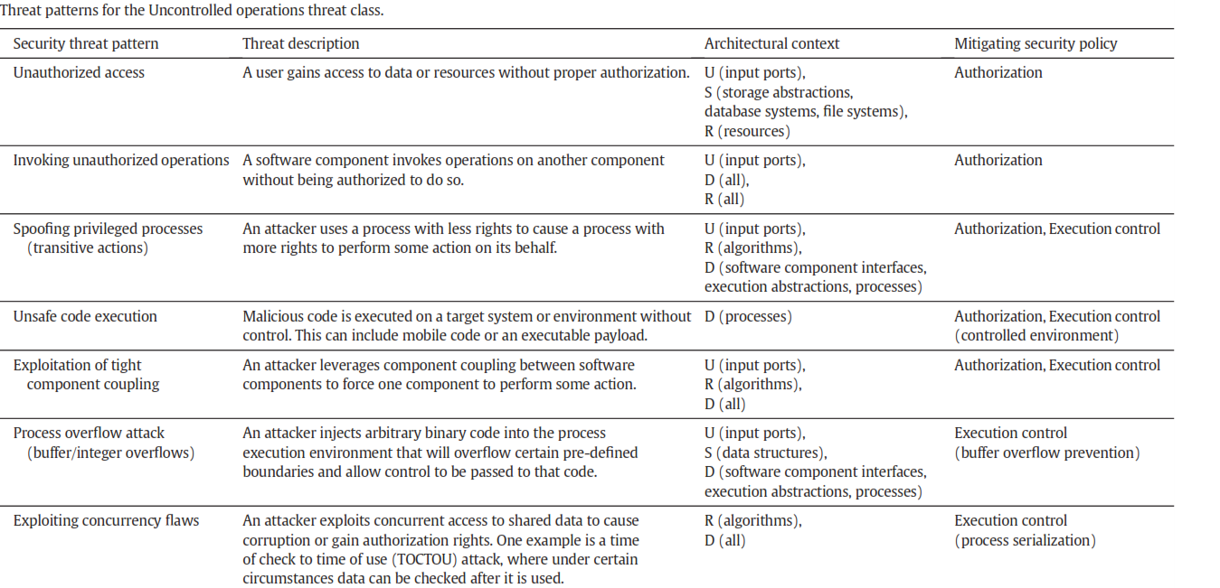

Slide 68
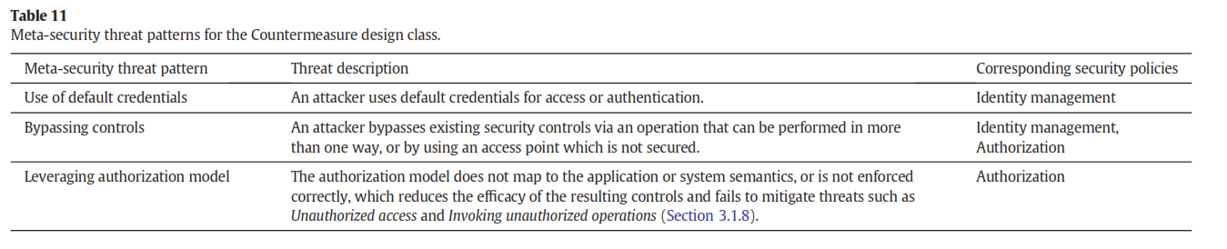

Slide 69
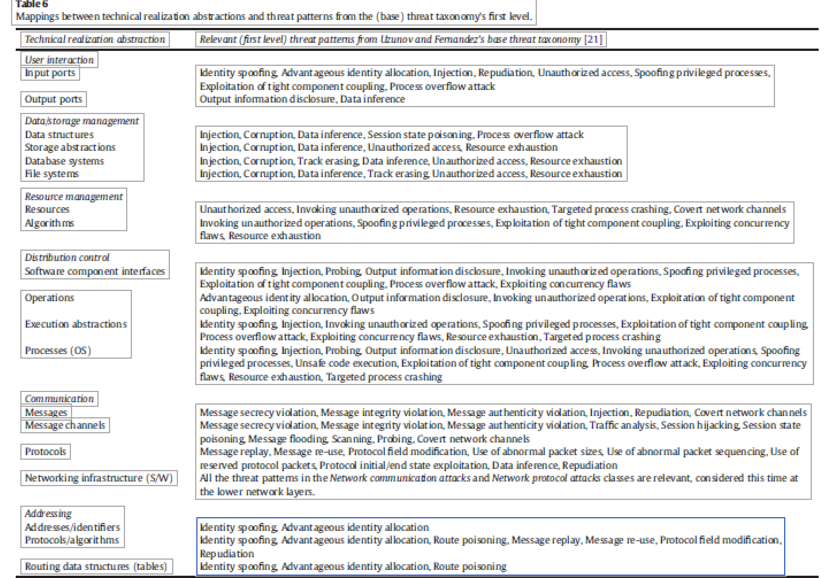

Slide 70
Other pattern variations
Privacy patterns—describe privacy policy definition, negotiation, and enforcement
Cyber-Physical security patterns---describe security mechanisms for physical systems: access to buildings, secure SCADA systems (to be seen later)
Dependability patterns---combine security and fault tolerance/safety/reliability

Slide 71
References
E.B. Fernandez and X. Yuan, “Semantic Analysis Patterns”, Procs. 19th Int. Conf. on Conceptual Modeling, ER2000 , Salt Lake City, UT, October 2000. Lecture Notes in Computer Science, Volume 1920 , 183-195
E. B.Fernandez, Nobukazu Yoshioka, Hironori Washizaki, and Joseph Yoder, "Abstract security patterns for requirements specification and analysis of secure systems'', Procs. of the WER 2014 conference, a track of the 17th Ibero-American Conf. on Soft. Eng.(CIbSE 2014), Pucon, Chile, April 2014
E.B.Fernandez, ''An abstract security pattern for Authentication and a derived concrete pattern, the Credential-based Authentication," Asian Pattern Languages of Programs Conference (AsianPLoP 2018).
Anton Uzunov, E. B Fernandez, Katrina Falkner, “Security solution frames and security patterns for authorization in distributed, collaborative systems”, Computers & Security, 55, 2015, pp. 193-234, doi: 10.1016/j.cose.2015.08.003

Slide 72
References
[Fer10] E.B.Fernandez, N. Yoshioka, and H. Washizaki, "A Worm misuse pattern", Procs. of the 1st Asian Conference on Pattern Languages of Programs(AsianPLoP 2010) , Tokyo, Japan, March 16-17, 2010, http://patterns-wg.fuka.info.waseda.ac.jp/asianplop/
[Fer11] E.B.Fernandez and Sergio Mujica, “Model-based development of security requirements”, CLEI (Latin-American Center for Informatics Studies) Journal. Vol. 14, No 3, paper 2, December 2011 Special issue of best papers presented at SCCC 2010, Antofagasta, Chile
[Fer12] E B. Fernandez, Ernest Alder, Richard Bagley, and Swati Paghdar, "A Misuse Pattern for Retrieving Data from a Database Using SQL Injection", RISE'12,Workshop on Redefining and Integrating Security Engineering, part of the ASE Int. Conf. on Cyber Security, Washington, DC, December 12-14, 2012
[Fer15] E.B.Fernandez, H. Astudillo, and G. Pedraza-Garcia, “Revisiting architectural tactics for security”, 9th European Conf. on Software Architecture (ECSA 2015), September 5-7, 2015, 55-69.

